Slide 1


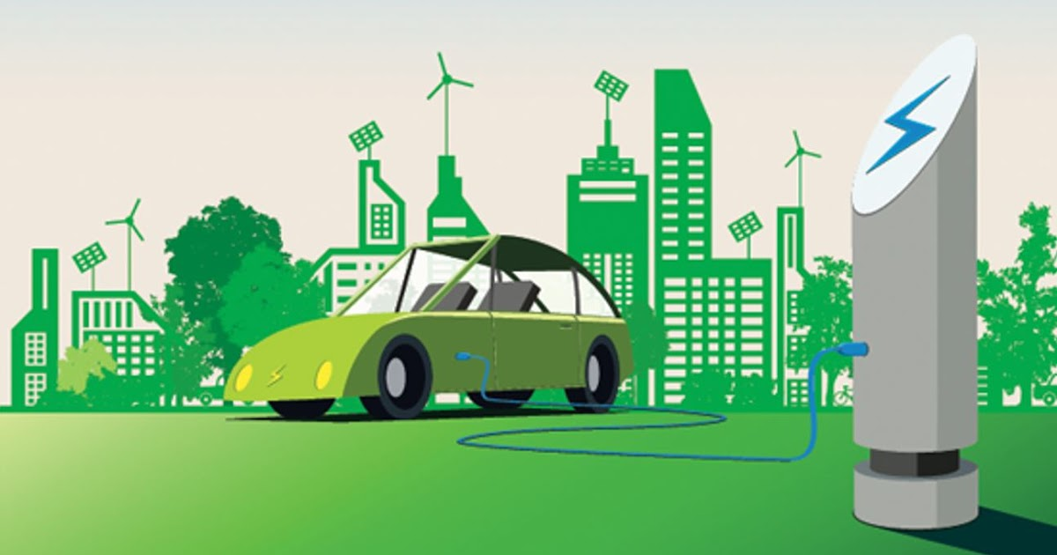
CODE BASICS RESUME PROJECT CHALLENGE 12
ELECTRIC VEHICLE ANALYSIS IN INDIA
Submitted by:
B. Vasantha Pyari

Slide 2
AGENDA :
PROBLEM STATEMENT
BACKGROUND
PROJECT OVERVIEW
INSIGHTS
PRIMARY QUESTIONS
SECONDARY QUESTIONS
RECOMMENDATIONS

Slide 3
PROBLEM STATEMENT
AtliQ Motors is an automotive giant from the USA specializing in electric vehicles (EV). In the last 5 years, their market share rose to 25% in electric and hybrid vehicles segment in North America. As a part of their expansion plans, they wanted to launch their bestselling models in India where their market share is less than 2%. Bruce Haryali, the chief of AtliQ Motors India wanted to do a detailed market study of existing EV/Hybrid market in India before proceeding further.

Slide 4
Background
Road EVs include a large range of vehicles from electric two-wheelers, three-wheelers (rickshaws), cars and electric buses. In addition, plug-in electric vehicles can be classified into two types: battery electric vehicles (BEVs), and plug-in hybrid electric vehicles (PHEVs). BEVs have an electric motor in place of combustion engine and use electricity from the grid stored in batteries. Which run only on batteries. Plug-in hybrid electric vehicles (PHEV) use batteries to power an electric motor and liquid fuel such as gasoline or diesel or they run using both fuel and Batteries.
EVs can go beyond the above-mentioned technology-based classification, and can be classified based on their attributes such as
i) charging time,
ii) driving range, and
iii) the maximum load it can carry.
Of these attributes,
the two most important characteristics of an electric vehicle of concern to the consumer are:-
Driving range (i.e. the maximum distance an EV can run when fully charged)
Charging time of batteries (i.e. the time required to fully charge the battery) and Charging time depends on the input power characteristics (i.e., input voltage and current), battery type, and battery capacity.

Slide 5
PROJECT OVERVIEW
Objective:
Comprehensive analysis of Electric Vehicle Sales in INDIA by manufacturers and State wise data.
Datasets:
For Primary analysis we analyze data from Electric vehicle sales by makers and Electric vehicle sales by states and the dim _date tables from Vahan Sewa
For the Secondary analysis https://pib.gov.in/ and firstpost.com
Data Correction:
Spelling Mistakes.
Standardizing the case formats.
Remove trailing and leading spaces.
Data Completeness:
EV sales by state wise data for Telangana and Lakshadweep are missing.

Slide 6


Slide 7
PRIMARY QUESTIONS

Slide 8
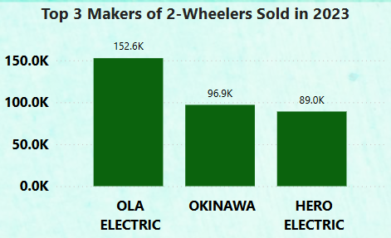
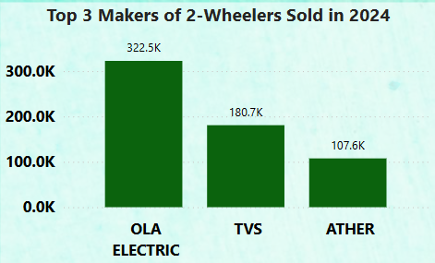
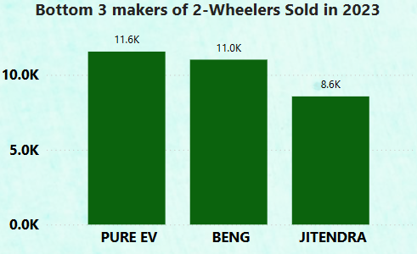
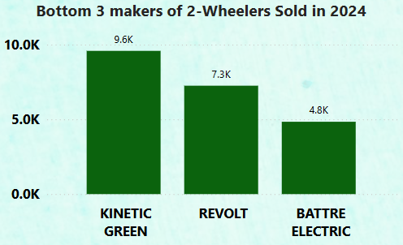
1. List the top 3 and bottom 3 makers for the fiscal years 2023 and 2024 in terms of the number of 2-wheelers sold.

Slide 9
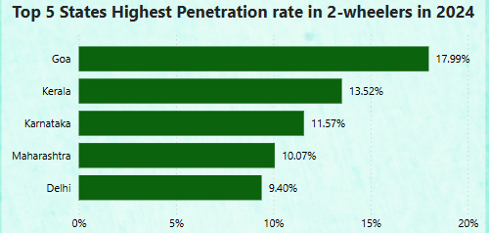
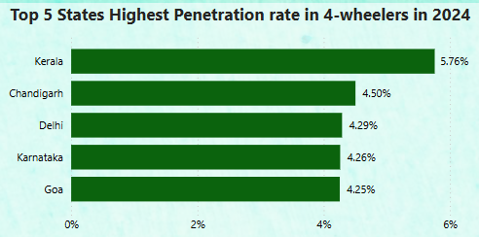
2. Identify the top 5 states with the highest penetration rate in 2-wheeler and 4-wheeler EV sales in FY 2024.
EV Penetration Rate (by state)=( Total EVs Sold in State/ Total Vehicles Sold in State ​)×100
EV = Electric Vehicle

Slide 10
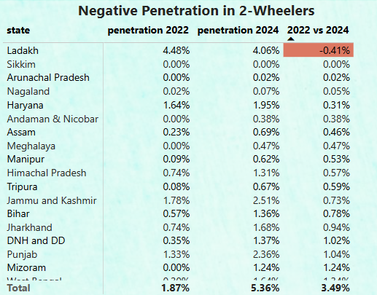
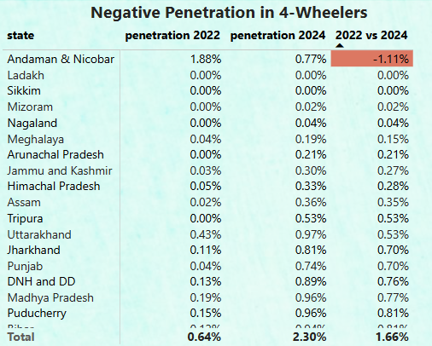
3. List the states with negative penetration (decline) in EV sales from 2022 to 2024?
Penetration Change in EV = Penetration rate of Ending Year - Penetration rate of Starting Year
EV = Electric Vehicle

Slide 11
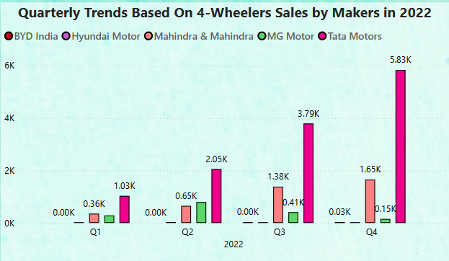
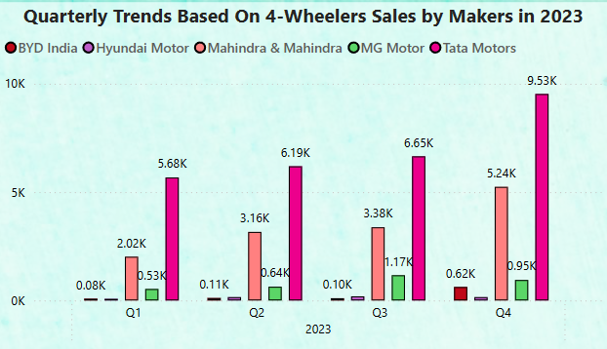
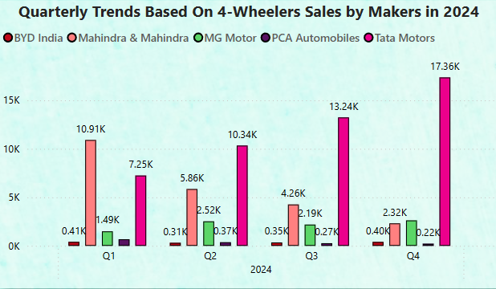
4. What are the quarterly trends based on sales volume for the top 5 EV makers (4-wheelers) from 2022 to 2024?
EV = Electric Vehicle

Slide 12
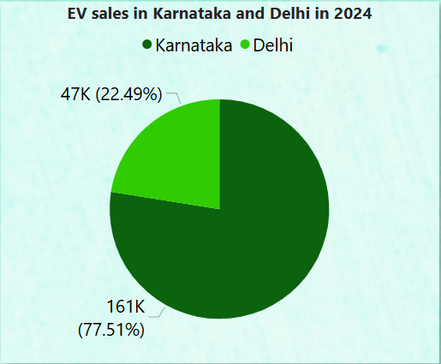
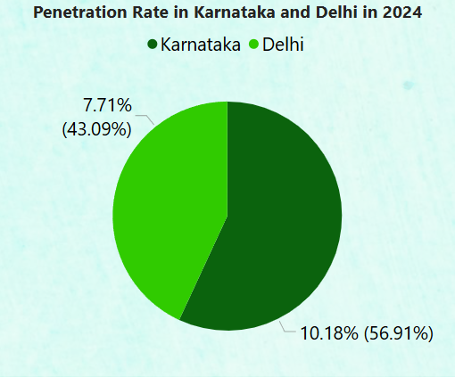
5. How do the EV sales and penetration rates in Delhi compare to Karnataka for 2024?
EV = Electric Vehicle

Slide 13
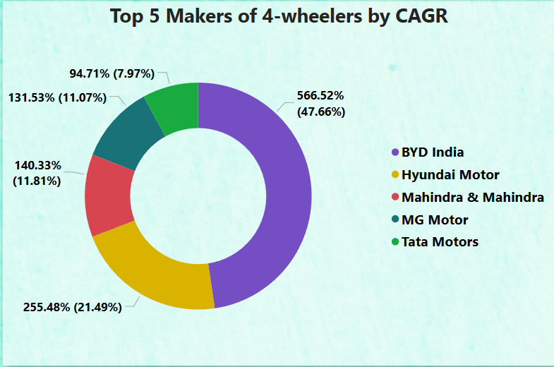
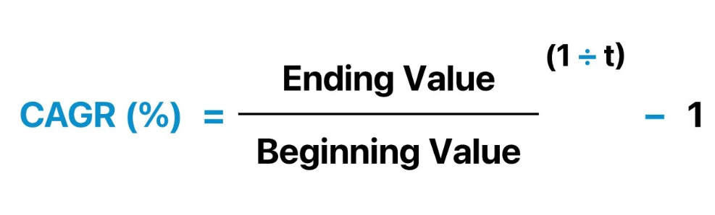
6. List down the compounded annual growth rate (CAGR) in 4-wheeler units for the top 5 makers from 2022 to 2024.
CAGR = Compound Annual Growth Rate
Ending value = Ending Year
Beginning Value = Starting Year
t = Ending year – Starting Year
CAGR = Compound Annual Growth Rate, EV = Electric Vehicle

Slide 14
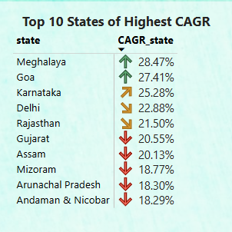
7. List down the top 10 states that had the highest compounded annual growth rate (CAGR) from 2022 to 2024 in total vehicles sold.
​
CAGR = Compound Annual Growth Rate, EV = Electric Vehicle

Slide 15
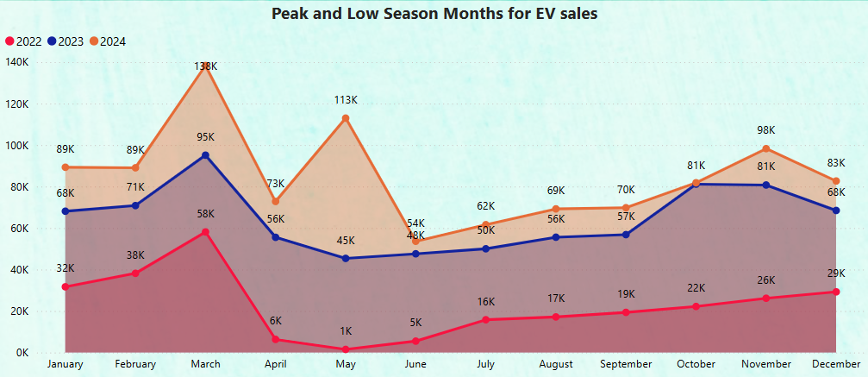
8. What are the peak and low season months for EV sales based on the data from 2022 to 2024?
2022
Peak Months
March, February
Low Months
May, June
2023
Peak Months
March, October
Low Months
May, June
2024
Peak Months
March, May
Low Months
June, July
EV = Electric Vehicle

Slide 16
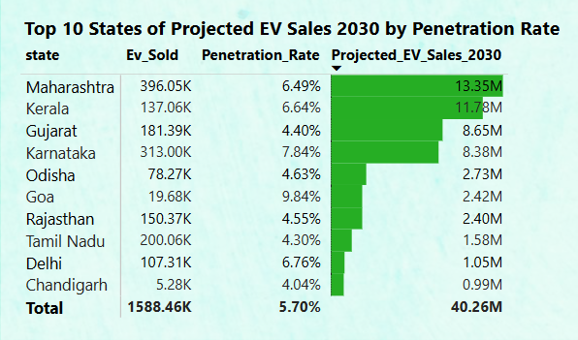
9. What is the projected number of EV sales (including 2-wheelers and 4 wheelers) for the top 10 states by penetration rate in 2030, based on the compounded annual growth rate (CAGR) from previous years?
Formula for Projected EV Sales 2030:
Projected Sales in Future Year=
EV Sales in Base Year×(1+CAGR)^Number
of Years from Base Year to Future Year
Calculation for Projected EV Sales 2030 :
EV sales in Base year =2024
CAGR= Compound Annual Growth Rate
No. of. Base Year to Future Year= 2030-2024
CAGR = Compound Annual Growth Rate, EV = Electric Vehicle

Slide 17
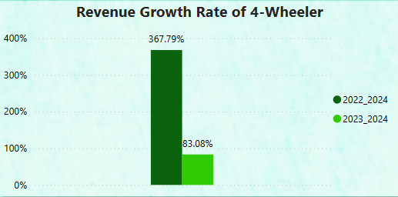
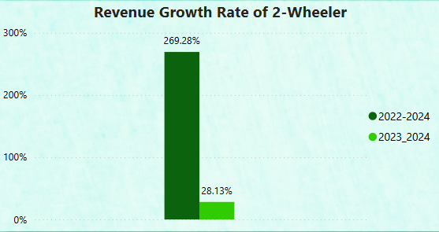
10. Estimate the revenue growth rate of 4-wheeler and 2-wheelers EVs in India for 2022 vs 2024 and 2023 vs 2024, assuming an average unit price.
2-Wheelers=85000
4-Wheelers=1500000

Slide 18
SECONDARY QUESTIONS

Slide 19
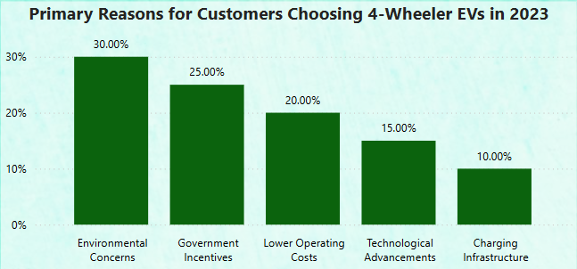
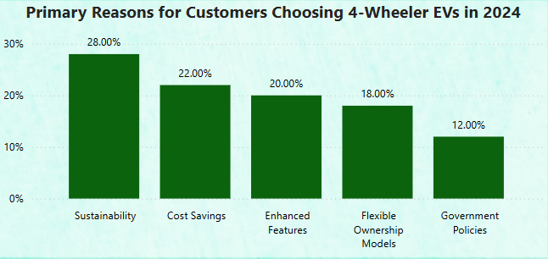
1. What are the primary reasons for customers choosing 4-wheeler EVs in 2023 and 2024 (cost savings, environmental concerns, government incentives)?
EV = Electric Vehicle

Slide 20
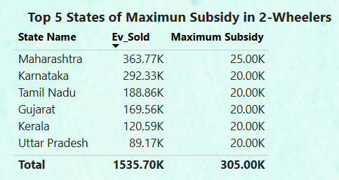
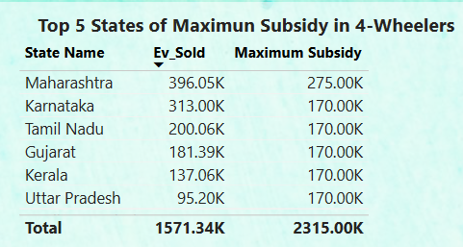
2. How do government incentives and subsidies impact the adoption rates of 2-wheelers and 4-wheelers? Which states in India provided most subsidies?
Based on the Data Maharashtra gives the Maximum Subsidies in 2-Wheelers and 4-Wheelers Category
EV = Electric Vehicle

Slide 21
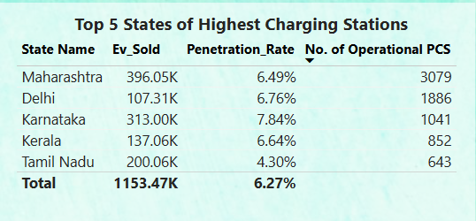
3. How does the availability of charging stations infrastructure correlate with the EV sales and penetration rates in the top 5 states?
EV = Electric Vehicle

Slide 22
4. Who should be the brand ambassador if AtliQ Motors launches their EV/Hybrid vehicles in India and why?
To select the ideal brand ambassador for AtliQ Motors' EV/Hybrid vehicles in India, we should consider factors such as:
Target Audience
Brand values
Product Positioning
Celebrity Image
Relevance
Based on these factors, here are some potential brand ambassadors for AtliQ Motors in India:
Bollywood Actors – such as John Abraham, Shah Rukh Khan.
Sports Persons – Such as MS. Dhoni, Virat Kohli , P.V.Sindhu.
EV = Electric Vehicle

Slide 23
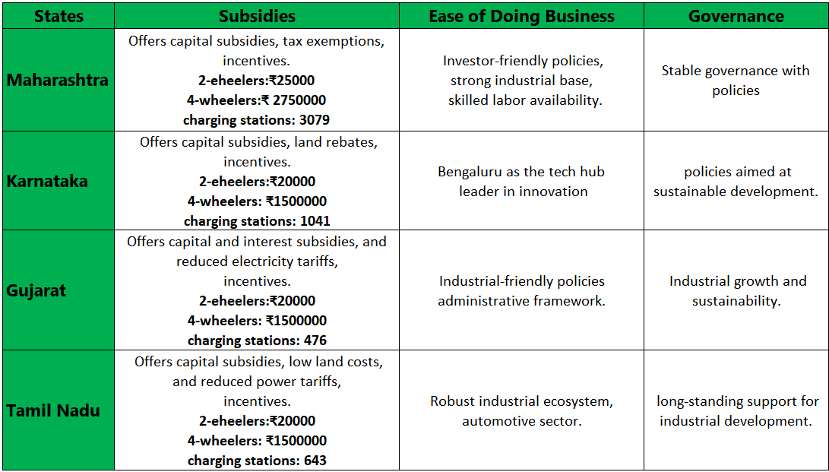
5. Which state of India is ideal to start the manufacturing unit? (Based on subsidies provided, ease of doing business, stability in governance etc.)
Based on data both Maharashtra and Karnataka are the Ideal State for Start Manufacturing Unit

Slide 24
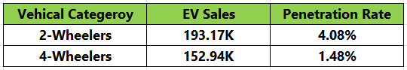
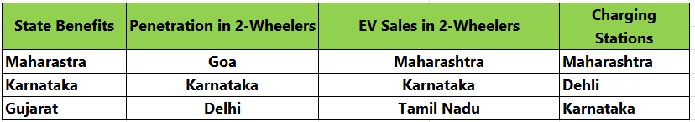
6. Top 3 recommendations for AtliQ Motors.
Category :
I Recommend to focus on 2-Wheelers to Start with.
2. Location :
I Recommend Maharashtra and Karnataka are the best location to launch 2-Wheelers Plant Based on
the Table Below (Analysis of Top 3 States Based on Various Criteria).
Offer Comprehensive charging Solutions :
Expand Charging Infrastructure :- Partner with Charging Network Providers.
Provide Home Charging Solutions :- Offer High Speed Home Charging options.
EV = Electric Vehicle

